Slide 1
Open Computer Vision
By - Ravi

Slide 2
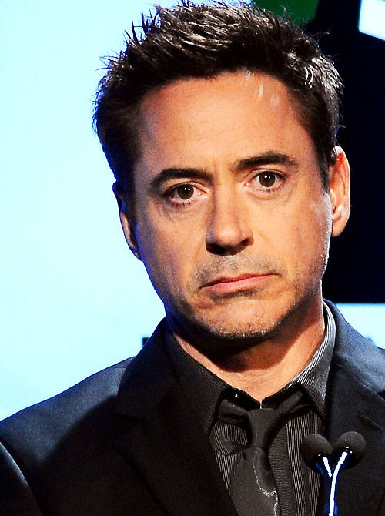
Viola-Jones Algorithm

Slide 3
Viola-Jones Algorithm

Slide 4
Viola-Jones Algorithm

Slide 5
Viola-Jones Algorithm

Slide 6
Viola-Jones Algorithm

Slide 7
Viola-Jones Algorithm

Slide 8
Viola-Jones Algorithm

Slide 9
Viola-Jones Algorithm

Slide 10
Viola-Jones Algorithm

Slide 11
Viola-Jones Algorithm

Slide 12
Viola-Jones Algorithm

Slide 13
Viola-Jones Algorithm

Slide 14
Viola-Jones Algorithm

Slide 15
Viola-Jones Algorithm

Slide 16
Viola-Jones Algorithm

Slide 17
Viola-Jones Algorithm
We have a huge problem with this approach: size of faces may differ
(window size is too small to include all the relevant features of a face
so the algorithm will not work fine)
~ some faces may be closer to the camera which means they
appear bigger than other faces in the background
scaleFactor: this feature in OpenCV compensates for this issue
The training uses 24x24 pixels images so we have to rescale the input image
~ so we can resize a larger face to a smaller one

Slide 18
Haar-features
Haar-wavelet is a sequence of rescaled square-shaped „functions”
~ very similar to Fourier-analysis
→ it was proposed by Alfréd Haar in 1909
→ they are like convolutional kernels
HAAR FEATURES ARE THE RELEVANT FEATURES FOR FACE DETECTION
edge features can detect edges
quite effectively
line features can detect lines
quite effectively

Slide 19
Haar-features

Slide 20
Haar-features
WE CAN REPRESENT THE MOST RELEVANT FEATURES WITH HAAR-FEATURES !!!

Slide 21

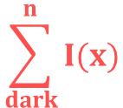

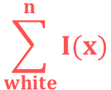
Haar-features
Viola-Jones algorithm will compare
how close the real scenario is to the
ideal case
1.) let’s sum up the white
pixel intensities
2.) calculate the sum of the
black pixel intensities
0
0
1
1
0.1
0.2
0.6
0.8
0
0
1
1
0.2
0.3
0.8
0.6
0
0
1
1
0.2
0.1
0.6
0.8
0
0
1
1
0.2
0.1
0.8
0.9
ideal Haar-feature
pixel intensities
0: white
1: black
these are real values
detected on an image
$$\frac{1}{n}$$
$$\sum_{dark}^{n}{I(x)}$$
$$\frac{1}{n}$$
$$\sum_{white}^{n}{I(x)}$$
Δ = dark – white =
-
Δ for ideal Haar-feature is 1
Δ for the real image: 0.74 – 0.18 = 0.56
The closer the value to 1, the more likely we have found a Haar-feature !!!
(of course we will never get 0 or 1: there are thresholds)

Slide 22
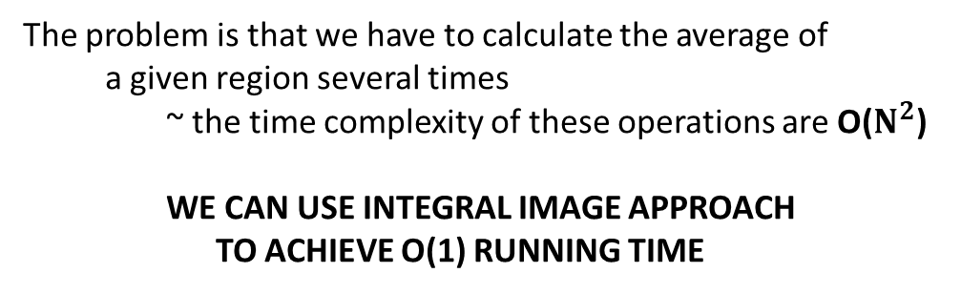
Integral Image
0.1
0.1
0.2
0.1
0.7
0.1
The problem is that we have to calculate the average of
a given region several times
~ the time complexity of these operations are O($N^{2}$)
WE CAN USE INTEGRAL IMAGE APPROACH
TO ACHIEVE O(1) RUNNING TIME
0.2
0.3
0.2
0.7
0.8
0.2
0.1
0.4
0.3
0.3
0.1
0.3
0.1
0.5
0.1
0.1
0.2
0.8
Why are there so many operations?
Because we have to use Haar-features with all
possible sizes and locations
~ 200k features to calculate !!!
→ every time we have to use a quadratic algorithm
~ we have to find a better approach
0.1
0.4
0.8
0.5
0.6
0.5
these are the same
kernels but with
different sizes

Slide 23
Integral Image
0.1
0.1
0.2
0.1
0.7
0.1
0.1
0.2
0.4
0.5
1.2
1.3
0.2
0.3
0.2
0.7
0.8
0.2
0.3
0.7
1.1
1.9
3.4
3.7
0.1
0.4
0.3
0.3
0.1
0.3
0.4
1.2
1.9
3.0
4.6
5.2
0.1
0.5
0.1
0.1
0.2
0.8
0.5
1.7
2.5
3.7
5.3
6.7
0.1
0.4
0.8
0.5
0.6
0.5
0.6
2.3
3.9
5.6
8.0
9.9
original image
integral image

Slide 24
Integral Image
0.1
0.1
0.2
0.1
0.7
0.1
0.1
0.2
0.4
0.5
1.2
1.3
0.2
0.3
0.2
0.7
0.8
0.2
0.3
0.7
1.1
1.9
3.4
3.7
0.1
0.4
0.3
0.3
0.1
0.3
0.4
1.2
1.9
3.0
4.6
5.2
0.1
0.5
0.1
0.1
0.2
0.8
0.5
1.7
2.5
3.7
5.3
6.7
0.1
0.4
0.8
0.5
0.6
0.5
0.6
2.3
3.9
5.6
8.0
9.9
original image
integral image

Slide 25
Integral Image
0.1
0.1
0.2
0.1
0.7
0.1
0.1
0.2
0.4
0.5
1.2
1.3
0.2
0.3
0.2
0.7
0.8
0.2
0.3
0.7
1.1
1.9
3.4
3.7
0.1
0.4
0.3
0.3
0.1
0.3
0.4
1.2
1.9
3.0
4.6
5.2
0.1
0.5
0.1
0.1
0.2
0.8
0.5
1.7
2.5
3.7
5.3
6.7
0.1
0.4
0.8
0.5
0.6
0.5
0.6
2.3
3.9
5.6
8.0
9.9
original image
integral image

Slide 26
Integral Image
0.1
0.1
0.2
0.1
0.7
0.1
0.1
0.2
0.4
0.5
1.2
1.3
0.2
0.3
0.2
0.7
0.8
0.2
0.3
0.7
1.1
1.9
3.4
3.7
0.1
0.4
0.3
0.3
0.1
0.3
0.4
1.2
1.9
3.0
4.6
5.2
0.1
0.5
0.1
0.1
0.2
0.8
0.5
1.7
2.5
3.7
5.3
6.7
0.1
0.4
0.8
0.5
0.6
0.5
0.6
2.3
3.9
5.6
8.0
9.9
original image
integral image

Slide 27
Integral Image
0.1
0.1
0.2
0.1
0.7
0.1
0.1
0.2
0.4
0.5
1.2
1.3
0.2
0.3
0.2
0.7
0.8
0.2
0.3
0.7
1.1
1.9
3.4
3.7
0.1
0.4
0.3
0.3
0.1
0.3
0.4
1.2
1.9
3.0
4.6
5.2
0.1
0.5
0.1
0.1
0.2
0.8
0.5
1.7
2.5
3.7
5.3
6.7
0.1
0.4
0.8
0.5
0.6
0.5
0.6
2.3
3.9
5.6
8.0
9.9
original image
integral image
SUM = 3.7

Slide 28
Integral Image
0.1
0.1
0.2
0.1
0.7
0.1
0.1
0.2
0.4
0.5
1.2
1.3
0.2
0.3
0.2
0.7
0.8
0.2
0.3
0.7
1.1
1.9
3.4
3.7
0.1
0.4
0.3
0.3
0.1
0.3
0.4
1.2
1.9
3.0
4.6
5.2
0.1
0.5
0.1
0.1
0.2
0.8
0.5
1.7
2.5
3.7
5.3
6.7
0.1
0.4
0.8
0.5
0.6
0.5
0.6
2.3
3.9
5.6
8.0
9.9
original image
integral image
SUM = 3.7 – 0.5

Slide 29
Integral Image
0.1
0.1
0.2
0.1
0.7
0.1
0.1
0.2
0.4
0.5
1.2
1.3
0.2
0.3
0.2
0.7
0.8
0.2
0.3
0.7
1.1
1.9
3.4
3.7
0.1
0.4
0.3
0.3
0.1
0.3
0.4
1.2
1.9
3.0
4.6
5.2
0.1
0.5
0.1
0.1
0.2
0.8
0.5
1.7
2.5
3.7
5.3
6.7
0.1
0.4
0.8
0.5
0.6
0.5
0.6
2.3
3.9
5.6
8.0
9.9
original image
integral image
SUM = 3.7 – 0.5 + 0.2

Slide 30
Integral Image
0.1
0.1
0.2
0.1
0.7
0.1
0.1
0.2
0.4
0.5
1.2
1.3
0.2
0.3
0.2
0.7
0.8
0.2
0.3
0.7
1.1
1.9
3.4
3.7
0.1
0.4
0.3
0.3
0.1
0.3
0.4
1.2
1.9
3.0
4.6
5.2
0.1
0.5
0.1
0.1
0.2
0.8
0.5
1.7
2.5
3.7
5.3
6.7
0.1
0.4
0.8
0.5
0.6
0.5
0.6
2.3
3.9
5.6
8.0
9.9
original image
integral image
SUM = 3.7 – 0.5 + 0.2 – 1.7 = 1.7
Why is it good? We can achieve O(1) running time for handling Haar-features
~ we assume these features are rectangles

Slide 31
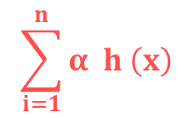
Computer Vision - Boosting
we can boost some part of the algorithm with the help of integral image approach
BUT there are way too many features
~ most of the features are irrelevant and not important at all
HOW TO SELECT THE BEST FEATURES? WITH BOOSTING !!!
we keep combining h(x)
weak learners (weak learner with
a single Haar-feature)
$$\sum_{i=1}^{n}{α h \left(x\right)}$$
H(x) = sign
i
i
final H(x) model which
is a strong classifier
every h(x) week learner
make a prediction
based on a single Haar-feature

Slide 32
Cascading
With boosting we can make the algorithm quite fast ...
But can we do even better?
→ we know that most of the image region is non-face region
→ it is a better idea to have a simple method to check if a window
is not a face region: if it is not, discard it in a single shot
→ do not process unnecessary regions: focus on regions where
there can be a face instead
THIS IS WHY WE USE THE CASCADE CLASSIFIER CONCEPT
Instead of applying all the ~6000 Haar-features: we use the most relevant ones
in the first iteration (first stages contain very less features: 1, 10, 15, 50...)

Slide 33
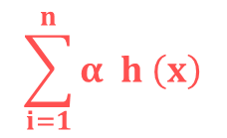
Cascading
How to find the most relevant features?
~ boosting algorithm has already found the best features
we keep combining h(x)
weak learners (weak learner with
a single Haar-feature)
$$\sum_{i=1}^{n}{α h \left(x\right)}$$
H(x) = sign
i
i
final H(x) model which
is a strong classifier
every h(x) week learner
make a prediction
based on a single Haar-feature
THE h(x) CLASSIFIERS WITH HIGHER α VALUES ARE THE RELEVANT FEATURES !!!
→ if the window does not contain the most relevant features we
can consider the next region on the image

Slide 34
Cascading
first feature
second feature
third feature
FACE
NOT A FACE
NOT A FACE
NOT A FACE

